Slide 1
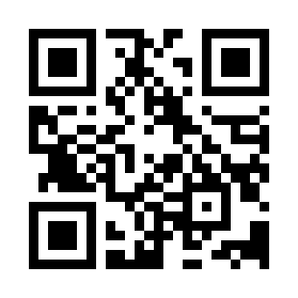


General SDLC Model Quiz
https://bit.ly/3nJRllt

